Slide 1
Uncover Privacy Design Flaws with LINDDUN Dr Md. Sadek Ferdous
COMP6236 - Software Engineering and Cyber Security

Slide 2
LINDDUN in a nutshell
LINDDUN (Linkability, Identifiability, Non-Repudiation, Detectability, Disclosure of Information, Unawareness, Non-Compliance)
Methodology to help software engineers with limited privacy expertise to introduce privacy early in the software development lifecycle
Model-based
Knowledge-based

Slide 3
LINDDUN process

Slide 4
Define DFDs: A Social Network

Slide 5
LINDDUN Privacy Threats
Threat Privacy property
Linkability | Unlinkability
Identifiability | Anonymity, Pseudonnymity
Non repudiation | Plausible Deniability
Detectability | Undetectability
Disclosure of Information | Confidentiality
Unawareness | Awareness
Non compliance | Compliance

Slide 6
Threat: Linkability (L)
Threat | Linkability
Privacy Property | Unlinkability
Definition | Distinguish whether 2 IOTs are related
Example | Inference of sensitive information e.g guess you are on a diet by linking your online search for recipes

Slide 7
Threat: Identifiability (I)
Threat | Identifiability
Privacy Property | Anonymity, Pseudonimity
Definition | Pinpoint the identity of a subject
Example | Identify a user in a database

Slide 8
Threat: Non-Repudiation (N)
Threat | Non Repudiation
Privacy Property | Plausible Deniability
Definition | Gather evidence so that a party cannot deny having performed an action
Example | Determine who express a vote in an online voting system

Slide 9
Threat: Detectability (D)
Threat | Detectability
Privacy Property | Undetectability
Definition | Distinguish whether an item of interest exists
Example | Revealing sensitive information e.g smart meters

Slide 10
Threat: Disclosure of Information (D)
Threat | Disclosure of Information
Privacy Property | Confidentiality
Definition | Exposing information to someone not authorized to see it
Example | Allowing someone to read the content of a database

Slide 11
Threat: Unawareness (U)
Threat | Unawareness
Privacy property | Awareness
Definition | User unaware of which information is providing to the system and the consequences of it
Example | Posting party pictures on Facebook and your boss see them

Slide 12
Threat: Non-compliance (N)
Threat | Non-compliance
Privacy property | Compliance
Definition | System not compliant with data protection legislation (e.g no privacy policy, no user consent)
Example | Disclosing data to third party without consent of the user

Slide 13
Map LINDDUN to DFD Elements
L I N D D U N
X
X
X
External Entity
X
X
X
X
X
X
Process
X
X
X
X
X
X
Data Store
X
X
X
X
X
X
Data Flow

Slide 14
Map LINDDUN to DFD Elements
L I N D D U N
Social Network DB
X
X
X
Data Store
User -Portal
X
X
Portal - Service
Data Flow
Service – Social Network DB
Portal
Process
Service
User
External Entity

Slide 15
Assumptions
When adding DFD elements, the number of threats grows exponentially
Limit by making assumptions
Assumptions are explicit or implicit choices to trust an element of the software to behave as expected
If a DFD element is trusted, it will not be subject to threats

Slide 16
Assumptions: Social Network 2.0
Internal DFD Elements are trustworthy
trust the processes and data flows within the trust boundaries
do not trust the user and its communication with the portal or the data store containing all the user’s information
Non-repudiation and detectability threats are not relevant for a social network

Slide 17
Map LINDDUN to DFD Elements
L I N D D U N
Social Network DB
X
X
X
Data Store
User -Portal
Portal - Service
Data Flow
Service – Social Network DB
NOT SUBJECT TO
THREAT ANALYSIS
Portal
Process
Service
User
External Entity

Slide 18
Identify threat scenarios
For each potential threat denoted by an “X” placed in the mapping table identify a concrete threat
Use the LINDDUN Privacy Threat Tree Catalog
There is a tree for each threat category applicable to a DFD element type
Each tree shows detailed preconditions for a threat category to materialize

Slide 19
Map LINDDUN to DFD Elements
L I N D D U N
Social Network DB
X
X
X
Data Store
User -Portal
Portal - Service
Data Flow
Service – Social Network DB
NOT SUBJECT TO
THREAT ANALYSIS
Portal
Process
Service
User
External Entity

Slide 20
Threat tree pattern example

Slide 21
Refining threats
DFD Element | Threat Type | Threat tree leaf nodes
Social Network DB | Linkability | Storing too much data Information disclosure of data store
User - Portal | Identifiability | Based on behavioral patterns Traffic analysis
User

Slide 22
Exercise (20 min)
Create a group of 4 students
Focus on the DFD element “User”
Use the Map LINDDUN to DFD elements on slide 13 to select some potential privacy threats that apply to the “User” element
Fill in table on slide 19 with “X” that match privacy threat categories applicable to the “User” element
For each “X” (privacy threat category) you need to use the Privacy Threat Tree Catalog to identify a concrete threat (leaf nodes of the tree)
Fill in table on slide 21 with privacy threat categories and concrete threats

Slide 23
Prioritize Privacy Threats
Risk level given by the combination of likelihood and impact
No guidelines provided to do that in practice

Slide 24
From threats to mitigation strategies
Use the mapping table that links mitigation strategies and LINDDUN threat trees
Once done the mapping look at the mitigation strategy taxonomy to select a specific mitigation approach

Slide 25
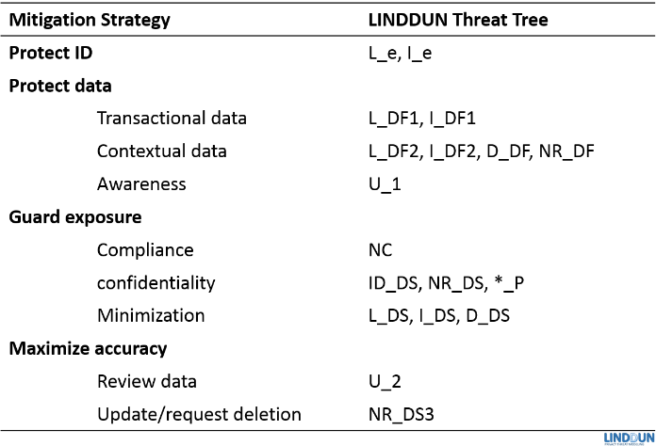
Map Mitigation Strategies to Threats
Notes:
Mitigations not /gs

Slide 26
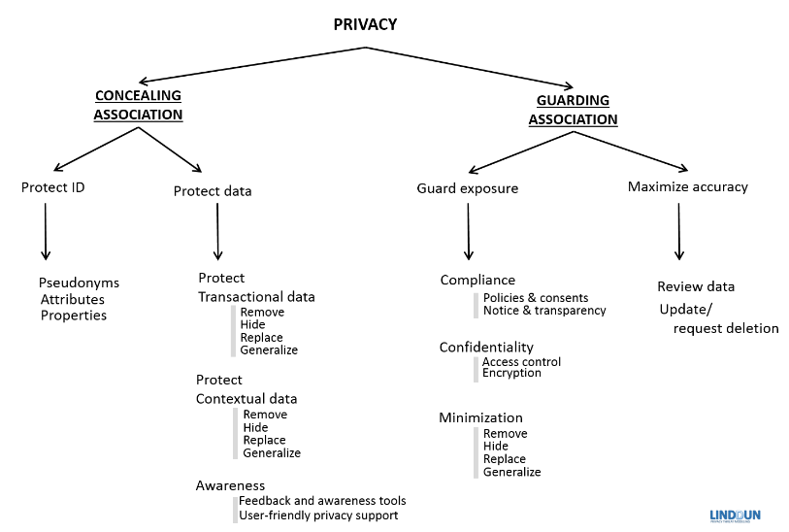
Mitigation strategies Taxonomy

Slide 27
Elicit Mitigation Strategies
DFD Element | Threat Type | Threat tree leaf nodes | Mitigation Strategy
Social Network DB | Linkability | Storing too much data Information disclosure of data store | - Minimize Collected Data By Generalization - Access-control
User - Portal
User

Slide 28
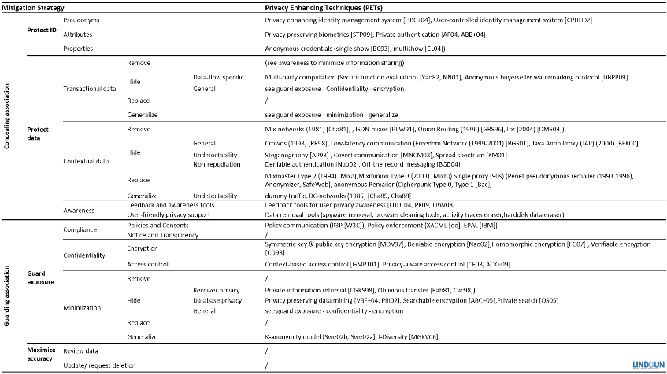
From Mitigation Strategies to PETs

Slide 29
Select Corresponding PETS
DFD Element | Threat Type | Threat tree leaf nodes | Mitigation Strategy | PET
Social Network DB | L | Storing too much data Information disclosure of data store | - Minimize Collected Data By Generalization - Access-control | K-Anonymity Privacy-aware access control
User - Portal
User

Slide 30
Exercise (20 min)
Focus on the DFD element “User”
For each concrete threat you have identified in the table on slide 21
use the Map Mitigation strategies to threats table on slide 25 to select a mitigation strategy for the threat
use the Mitigation Strategies Taxonomy on slide 26 to identify a specific mitigation strategy for the threat
For each mitigation strategy use Mitigation Strategies to PETs table on slide 28 to identify technology to implement the mitigation strategy
Fill in table on slide 29 with mitigation strategies

Slide 31
Summary
LINDDUN is a threat modeling methodology that helps software engineers with little privacy expertise in identifying and mitigating privacy threats early in the SDLC
It comes with bundled knowledge
taxonomy of privacy threats
catalog of privacy threats tree patterns
standard mitigations for privacy threats

Slide 32
Reading Material
Privacy
Pfitzmann & Hansen (2010): A terminology for talking about privacy by data minimization: Anonymity, Unlinkability, Undetectability, Unobservability, Pseudonymity, and Identity Management
Guerses (2010): Multilateral Privacy Requirements Analysis in Online Social Network Services (PhD thesis) section 2.2 (pg. 22-32)
Guarda and Zannone (2008): Towards the development of privacy-aware systems
LINDDUN web site
https://distrinet.cs.kuleuven.be/software/linddun/

Slide 33
Assignment for Thursday lecture
Read the paper of UML diagrams that I will upload on the NoteWiki
Objective: Recap what is a software architecture and which are the main diagrams used to represent it
UML class diagram
UML sequence diagram
UML component diagram

